Slide 1
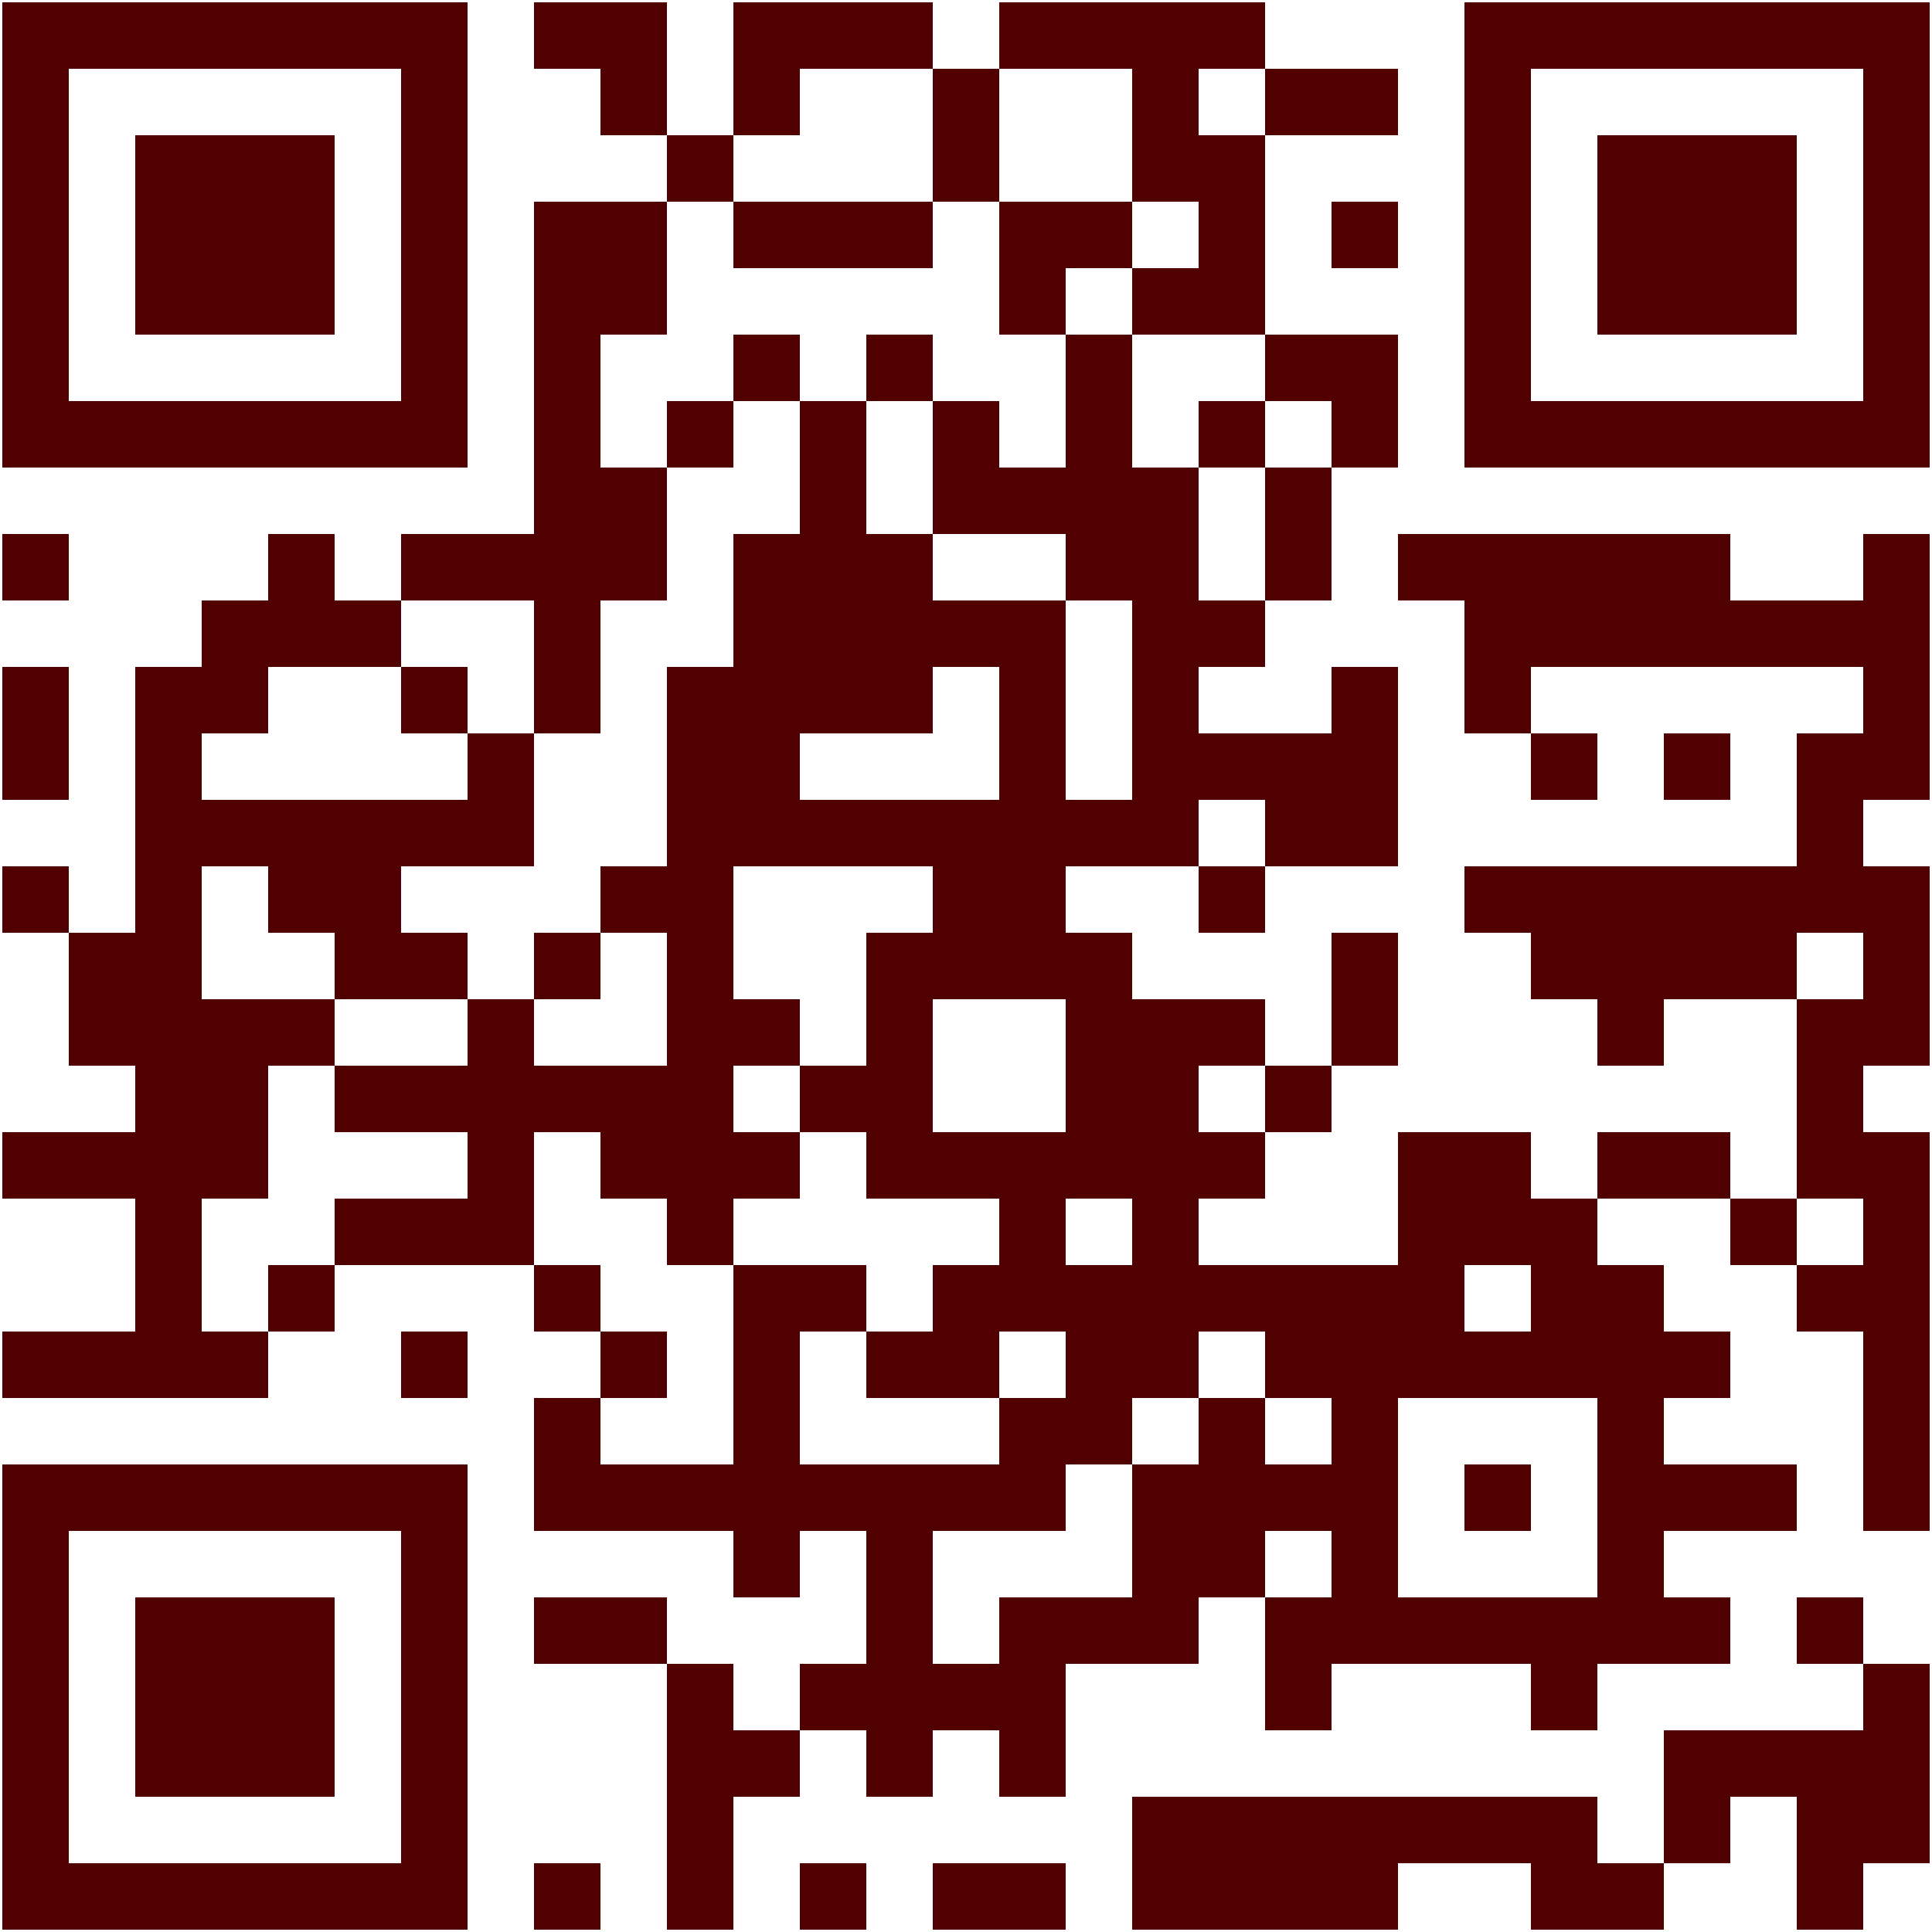
Summer Undergraduate Research Programs Coordination Meeting Summer 2026
Download Policies Packet:
https://tx.ag/2026ugrpolicies
Office of Undergraduate Research
ugr@tamu.edu

Slide 2
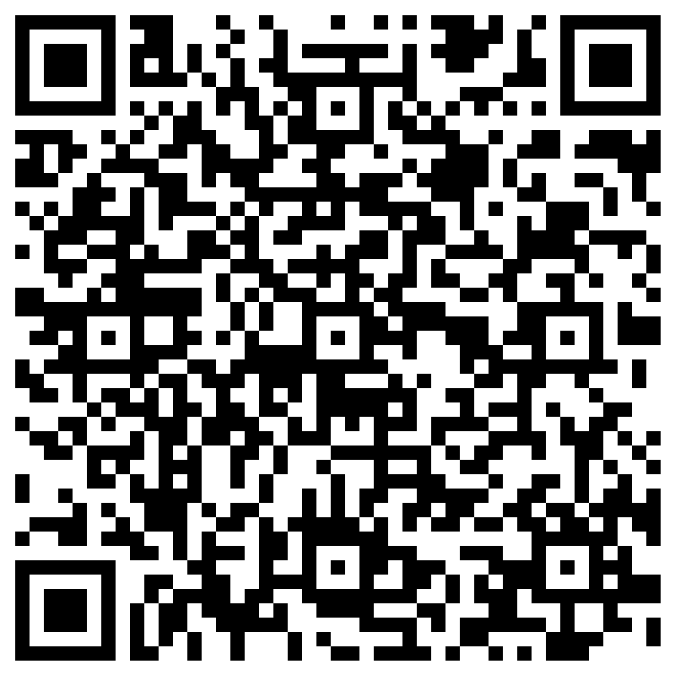
Download PDF
https://tx.ag/2026ugrpolicies
A revised packet, meeting summary, and new webpages will be available next week.
https://ugr.tamu.edu/resources/summer.html
Program Registration
https://forms.office.com/r/BBr7JDxJkZ

Slide 3
Agenda
Listserv updates
General overview of policies
No significant changes this year
New resources incoming

Slide 4
Listserv
To remain subscribed:
No action is needed.
To unsubscribe:
Send an email to: UNDERGRAD-RESEARCH-signoff-request@LISTSERV.TAMU.EDU
Leave the subject line blank
Enter the following in the email body: UNSUBSCRIBE
Please share the following instructions with others who may wish to subscribe:
Send an email to: listserv@listserv.tamu.edu
Leave the subject line blank
Enter the following in the email body: SUBSCRIBE UNDERGRAD-RESEARCH YourFirstName YourLastName

Slide 5
Application of Policies
Note: Some of the policies in this packet apply only to externally-funded programs that operate in the summer semester (e.g., NSF-REU sites).
Reach out to ugr@tamu.edu for clarification as needed.

Slide 6
Major Processes
Admitting Non-degree Seeking Students
Placing All Externally-funded Students in TAMU 499
Role of Student Business Services
Requesting Scholarship Stipends to Pay Students

Slide 7
Admissions
Process for non-Texas A&M students as non-degree seeking students for the summer term
Benefits:
Track participation in high-impact practices and research activities
Enroll students in 0- or 1-credit hour courses
Verify bacterial meningitis vaccinations
Eligible for early graduate admissions program
Deadline to Apply: May 1, 2026

Slide 8
Admissions
Jessica Pitt
Program Coordinator I
Connie Coleman
Director
Tashia Cole
Assistant Director

Slide 9
TAMU 499/Registrar
TAMU 499 is a mechanism created to centralize the processing and tracking of students participating in externally-funded summer undergraduate research programs.
The TAMU 499 roster is used by administrative units to automate processes and provide students access to university systems and services.
It applies to both current TAMU students and non-TAMU (non-degree seeking) students.
The registration process can start as early as April, if students have been admitted or are current Texas A&M students.
Placement in TAMU 499 can be combined with enrollment in other courses.

Slide 10
Registrar
Reminders about the TAMU 499 placeholder course:
TAMU 499 is non-credit bearing.
TAMU 499 does not appear on a student’s transcript.
TAMU 499 does not appear in Howdy.
TAMU 499 does not appear in Navigate.
How to enroll students in the TAMU 499 placeholder course:
The CRN for the College Station* section (TAMU 499-300) is 27755.
The CRN for the Galveston section (TAMU 499-300) is 30633.
Advisors can find the CRN by searching SSASECQ in Compass using the term, TAMU, and 499. Or, they can use SSASECT.
*Students from the School of Dentistry, Higher Education Center at McAllen, and the Health Science Center should be placed in the College Station section.

Slide 11
Registrar
Nick Piwonka
Director
Sarah Coppedge
Assistant Registrar
SEE PAGE(S) IN PACKET

Slide 12
Student Business Services
Students needing course credit for externally funded experience:
Must be enrolled in TAMU 499 course
Can also be enrolled in a 1-credit hour 485 or 491 course in their department
Required Tuition and Fees for the 1-credit hour 485 or 491 course will be WAIVED by SBS as long as students are also in the TAMU 499 course.
Tuition and fees are NOT WAIVED for any other courses besides the 0-credit hour TAMU 499 course and a 1-credit hour 491 or 485 course.

Slide 13
Late Fees
It is crucial students are registered for the TAMU 499 course prior to the 1st day of classes of the Summer I term. Students who are registered after that date may be subject to a $100 Late Registration Fee in accordance with state statutes and census dates. If you are unable to enroll your students in the TAMU 499 prior to the 1st day of classes, please let the Office of Undergraduate Research staff know and we will work with SBS to resolve any issues.
SEE PAGE(S) IN PACKET

Slide 14
Student Business Services
LeeAnn Pickett
Assistant Director
Marissa Perez
Financial Management Supervisor I

Slide 15

For Scholarship Administrators
Scholarships & Financial Aid
https://financialaid.tamu.edu
SEE PAGE(S) IN PACKET

Slide 16
Scholarships & Financial Aid
Departments paying students via scholarships must use accounts tied to fund codes for the scholarship to be paid out.
Important: Accounts do not automatically receive fund codes. Fund codes must be specifically requested and applied to accounts.
Fund codes must be requested at least two months in advance. This means that if you wish to request a scholarship payment on May 15, you must request a new fund code before March 15.

Slide 17
Scholarships & Financial Aid
The scholarship payment request form you use to request payment to a student depends on the number of credit hours a student is enrolled in during the summer 2026 term.
Students Enrolled in 1 or More Credit Hours
Students Enrolled in Zero Credit Hours or Not Enrolled in Any Courses (i.e., “non-enrolled”)

Slide 18
Scholarships & Financial Aid
Allison Kalinec
Associate Director
Elizabeth Costea
Financial Aid Advisor

Slide 19
University Health Services
The health center fee is facilitated the TAMU 499 course.
If students are not in the TAMU 499 course and not assessed the fee, students do not have access to medical services through UHS unless paid for separately.
Students who use UHS are still responsible for the cost of the services. While insurance is not required by UHS, filing charges to insurance may benefit the student.
However, it takes 60-90 days to hear back from insurance companies. Students may have balances on their accounts after they leave the university. Advisors should work directly with their students and UHS to pay off the balance through Howdy.
SEE PAGE(S) IN PACKET

Slide 20
University Health Services
Brittany Pekar
Assistant Director, Client Services

Slide 21
Student Health Insurance (OREC)
Can programs ask for proof of insurance?
Yes, but it is not required.
Can uninsured students get TAMU health insurance?
Yes, but only if they are registered for 9+ credit hours, which is not the case for most REU and summer research students.
Can programs pay for health insurance on behalf of the student?
Yes, but the benefit must be documented in a stipend offer letter or other written agreement. Accounts Payable must report this benefit to Scholarships & Financial Aid.
Are there any other options?
Yes, programs can buy special event insurance through OREC for the research participants attending an event, if the program believes the event to pose a safety risk to the researchers.
SEE PAGE(S) IN PACKET

Slide 22
Office of Risk, Ethics, and Compliance
Grace Mullendore
Insurance Services Coordinator

Slide 23
International Student & Scholar Services (ISSS)
All international student check-ins must be completed online through the ISSS Portal.
F-1, J-1, and J-2 dependents are required to have health insurance coverage.
Students who have F-1/J-1 status from another U.S. institution do not have authorization to work at TAMU unless their school or the U.S. government granted them some sort of work authorization to work here.
SEE PAGE(S) IN PACKET

Slide 24
International Student & Scholar Services (ISSS)
Jie Fan
Associate Director

Slide 25
Education Abroad
Group international REUs: Contact EA at least six months prior to your planned departure
See proposal deadlines in packet.
Contact OREC if you are scheduling domestic field trips with your summer students.
SEE PAGE(S) IN PACKET

Slide 26
Education Abroad
Irene Scott
Program Manager
Pascale Parker
Director
Dr. Christie Dunn
Associate Director

Slide 27
Residence Life
Schedule:
10-week Classes Start: May 26
Move-in: May 22
10-week Classes End: August 4
Finals: August 5-6
Move-out: August 8
Available Dorms:
Fowler, Hughes and Schumacher Hall
$30 per night for a Single Room
Single rooms only available to REUs
SEE PAGE(S) IN PACKET

Slide 28
Residence Life
Lisa Pierce
Program Manager
Ally Fulco
Administrative Coordinator

Slide 29
Clery Act Compliance
Required training for CSAs
Reporting requirements
Missing student instructions
SEE PAGE(S) IN PACKET

Slide 30
Clery Act
Michelle Jackson
Compliance Officer III

Slide 31
Dining
Students must be enrolled for the term to purchase meal plans.
Students enrolled for 0-credit hours are still eligible for meal plans.
Students will need to request their own meal plan.
Students can only access meal plans and/or dining dollars using a TAMU ID.
SEE PAGE(S) IN PACKET

Slide 32
Training and Compliance
EHS General Lab Safety Training (online)
Password will be emailed to listserv when updated
IRB, IACUC, IBC Training
Responsible Conduct of Research Training
SEE PAGE(S) IN PACKET

Slide 33
Compliance and Training
Sergio Luna
Supervisor, Environmental Health and Safety
Kelsey McKenzie
Research Compliance Coordinator
irb@tamu.edu, ibc@tamu.edu, animalcompliance@tamu.edu

Slide 34
Early Admissions Program
Victor Gongora
Program Coordinator II
SEE PAGE(S) IN PACKET

Slide 35
New Resources
Emergency Contact Information Collection Template
Emergency Services Contact Information
Other requested resources or templates?

Slide 36
Questions? ugr@tamu.edu

